Slide 1
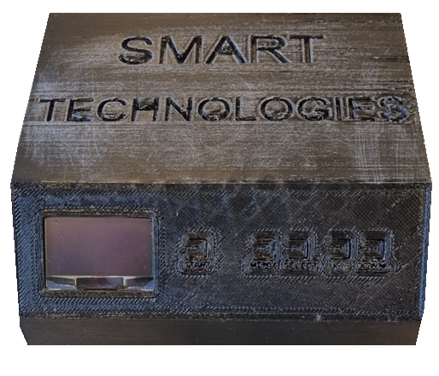
Control a Stepper motor
Ayman Miri & Christian Steffen

Slide 2
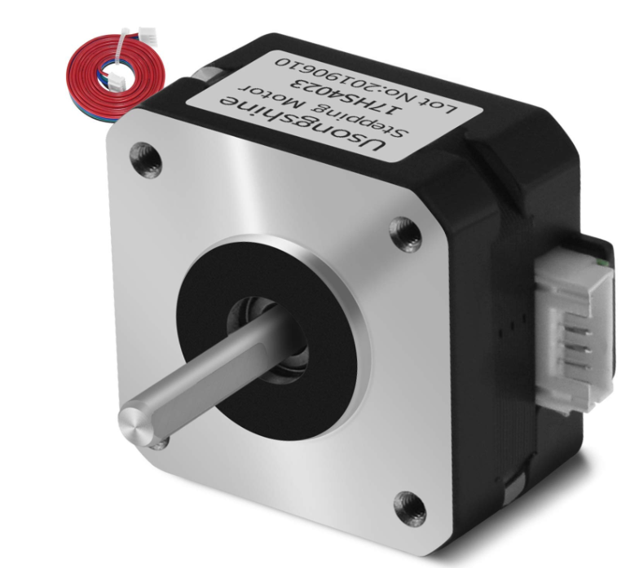
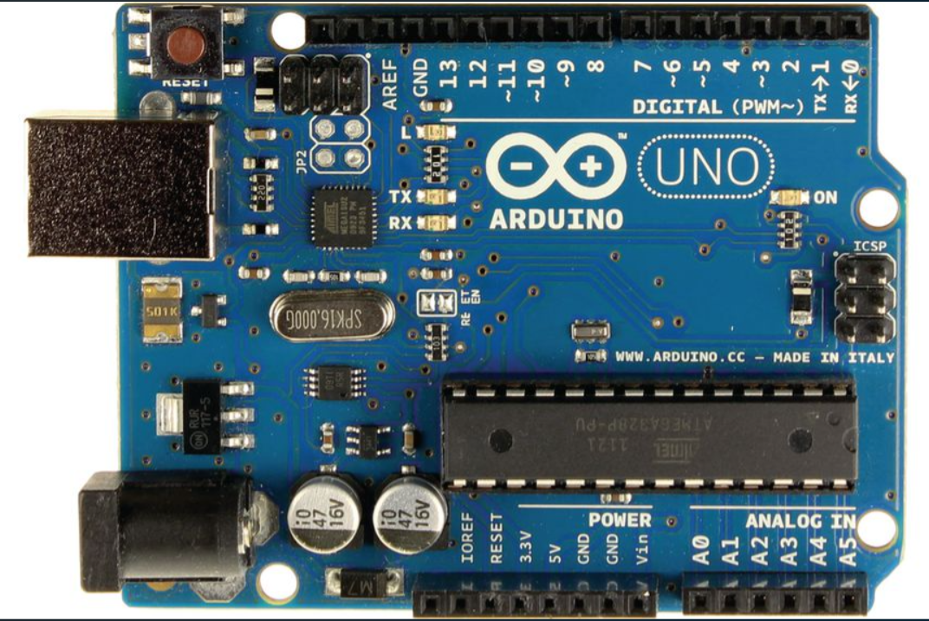
Contents
Introduction
What is a stepper motor?
How we can drive it?
Driving techniques of a stepper motor
Flowchart of the program
Function Diagram
Building the 3D Box
Evaluation

Slide 3
Introduction
Our task:
Write a program for a stepper motor with some parameters:
Speed
Direction
Steps
Built up a circuit: (including)
Driver
OLED-Display
Arduino Uno
Buttons 5x
Powersupply

Slide 4
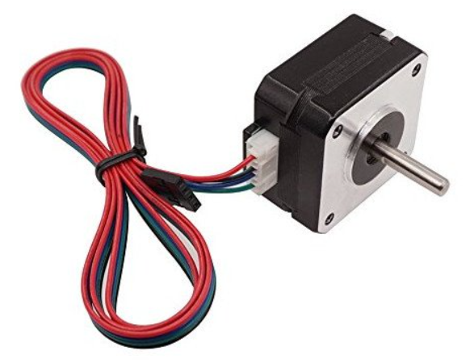
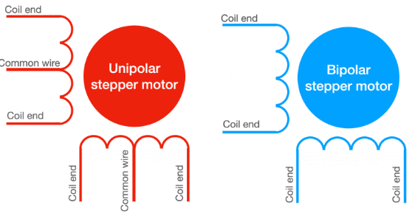
Stepper motor:
Is a brushless, synchronous electric motor
converts digital pulses into mechanical shaft rotation
our motor (SM-17HS4023) can manage:
360° in 200 steps
There are 2 types of stepper motor which exists:
Unipolar (divided coils)
Bipolar
WHAT IS A STEPPER MOTOR?
Stepper motor we use: SM-17HS4023

Slide 5
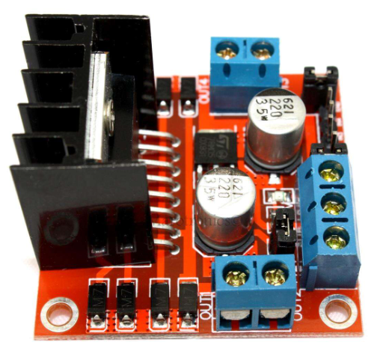
Is a brushless, synchronous electric motor
converts digital pulses into mechanical shaft rotation
our motor (SM-17HS4023) can manage:
360° in 200 steps
There are 2 types of stepper motor which exists:
Unipolar (divided coils)
Bipolar
How we can drive it?
L298N

Slide 6
Vielen Dank
jemand@example.com

